Slide 1
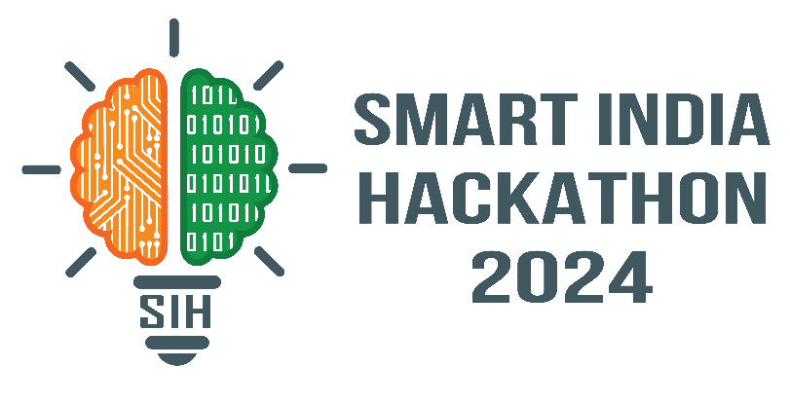
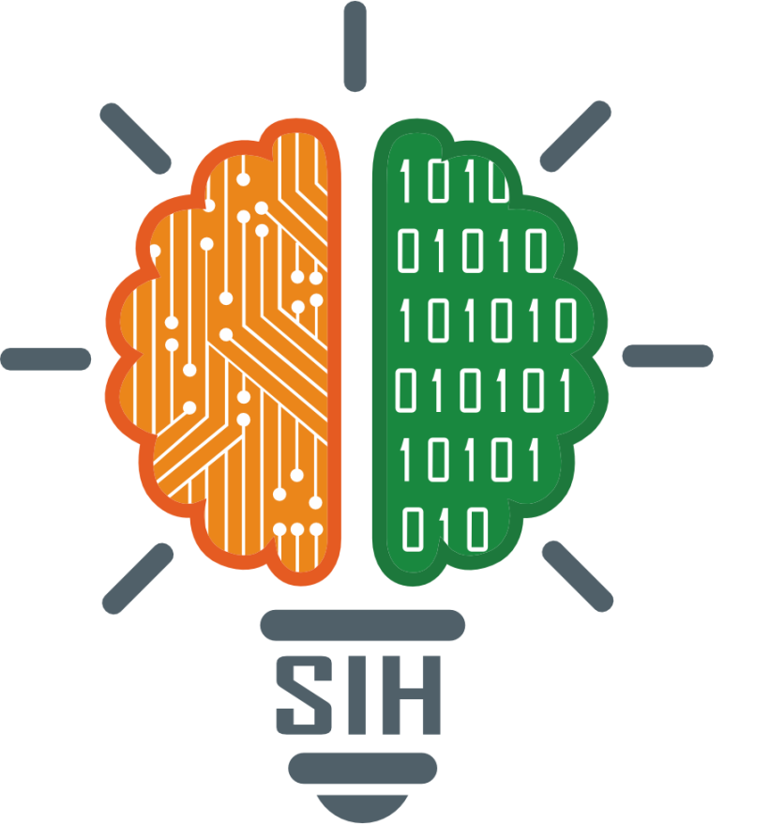
SMART INDIA HACKATHON 2024
TITLE PAGE
Problem Statement ID – SIH1598
Problem Statement Title- Student Innovation
Theme- Heritage & Culture
PS Category- Software
Team ID - 9511
Team Name - Nivaran

Slide 2
IDEA TITLE
Nivaran
Proposed Solution
Idea :
Solution :
Prototype :
Proposed Solution: Our website highlights India's cultural heritage, emerging tech trends, local traditions, and hidden gems with SEO :
Explore heritage value: Discover significant places, traditions, and foods with detailed insights.
Word of Mouth: Sustainable business platform for local services with sponsorship options, leveraging word-of-mouth marketing and enhanced visibility through targeted listings.
Key Features:
State and City Pages: Showcase the rich history, culture, and heritage of each region with detailed insights.
User Engagement: Interactive features like reviews, ratings, and recommendations enhance user experience.
Affiliate Programs: Monetize through partnerships with platforms like Airbnb and local tour guides.
Community Section: Plans to engage foreign users and promote Indian culture globally, fostering cultural exchange.
Preservation of Culture: Utilizing digital platforms to document and share India's heritage globally for cultural preservation.
Support for Local Economies: Promoting sustainable tourism and local businesses through digital exposure and e-commerce integration.
Enhanced Travel Planning: Simplifying travel experiences with AI-driven recommendations, revealing hidden gems and local traditions.
Government Benefits: Supports heritage conservation, boosts tourism, and streamlines local governance with centralized cultural data.
Education: Provides educational resources, enhancing awareness and understanding of India's diverse historical heritage.
Social Impact: Empowers locals by fostering pride, identity, and commitment to preserving and promoting heritage.
Accessibility: Provides an intuitive, user-friendly interface, ensuring information access for all tech proficiency levels.
Curated Cultural Content: Delivers immersive Indian cultural insights, enhancing travel experiences with historical depth and context.
Modern Design: Integrates traditional Indian art with contemporary UX, boosting user engagement and cultural representation.
Interactive Features: Features user-generated reviews and recommendations, creating a vibrant community of cultural enthusiasts.
Future Expansion: Aims to launch a community section for global users, promoting Indian culture and local artistry.
Personalized Recommendations: Offers tailored cultural suggestions based on user preferences for a more relevant exploration experience.
Cultural Blog and Articles: Regularly updated blog posts and articles showcasing cultural trends, local stories, and historical insights, ensuring engaging and fresh content for diverse audiences.

Slide 3




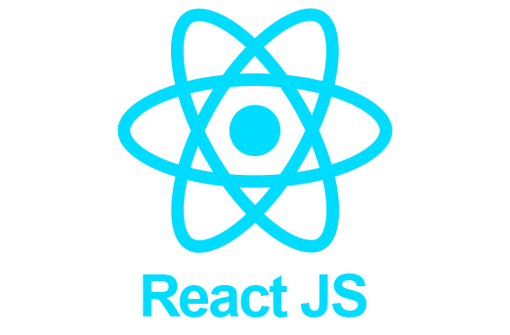
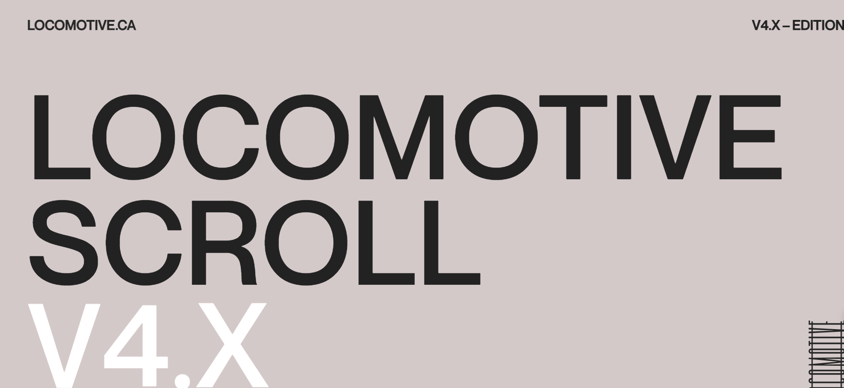


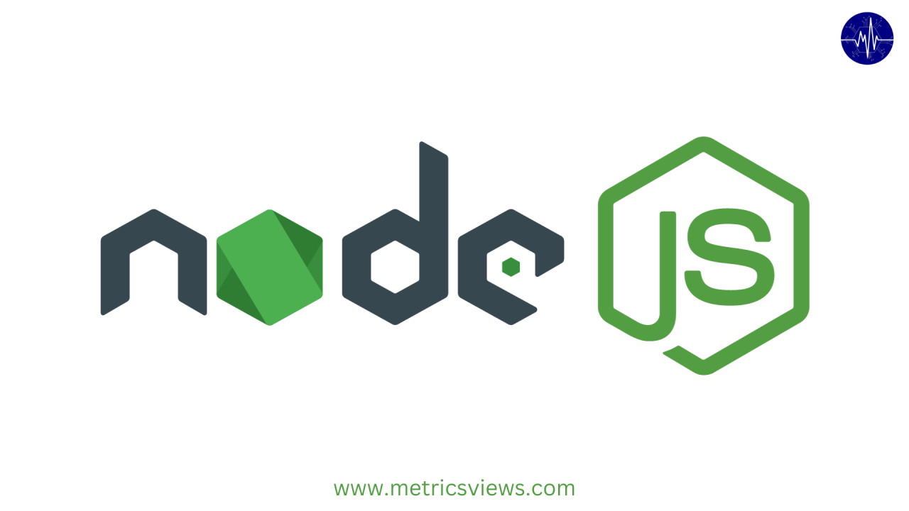


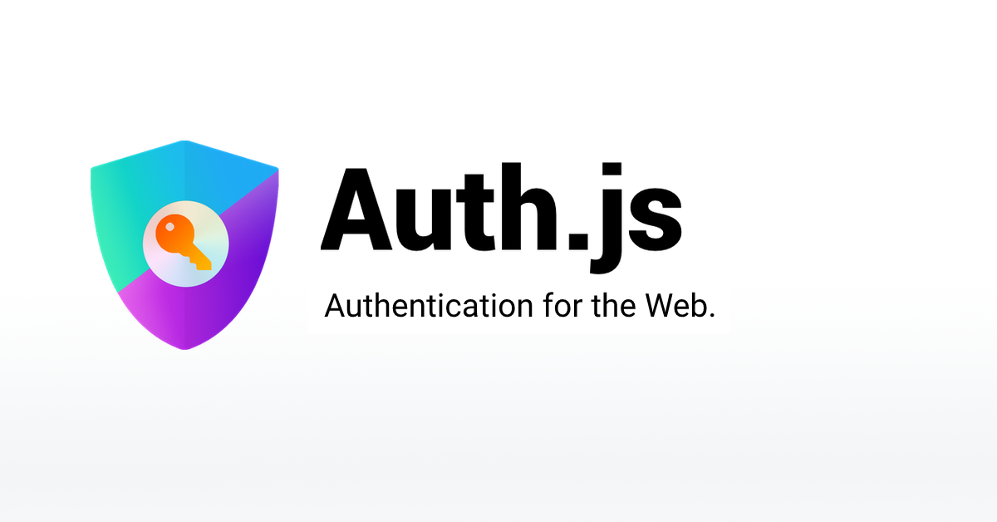


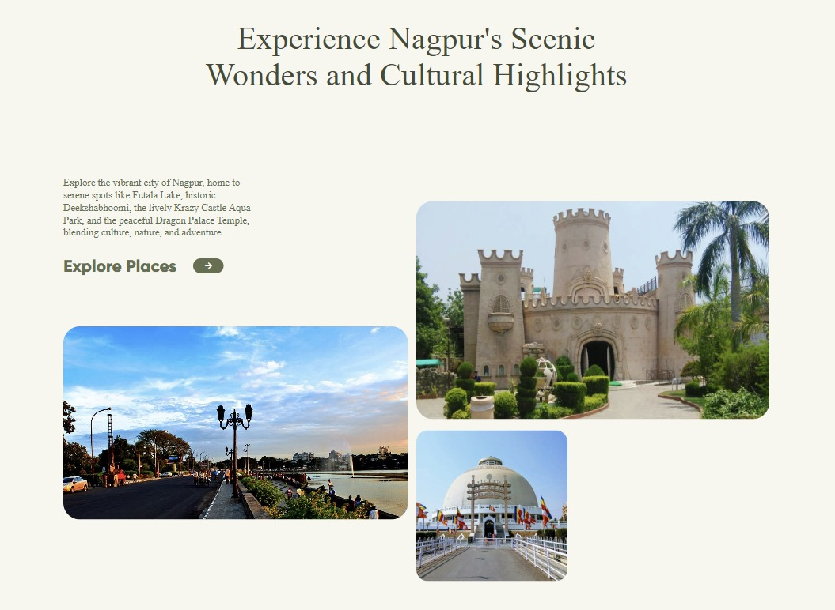
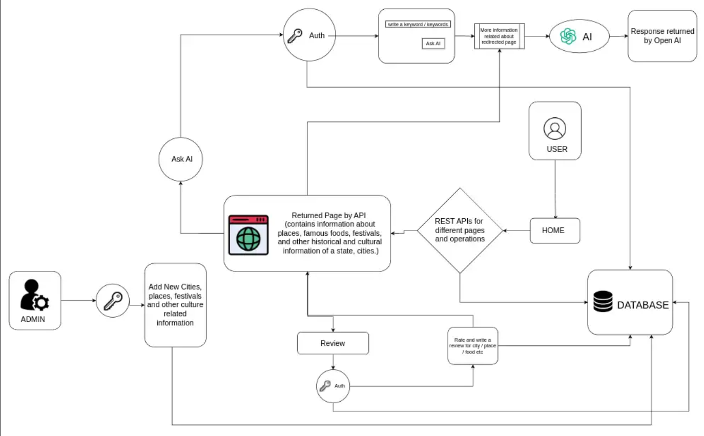
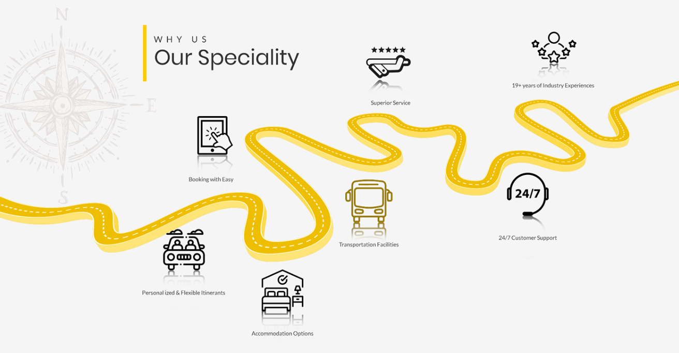
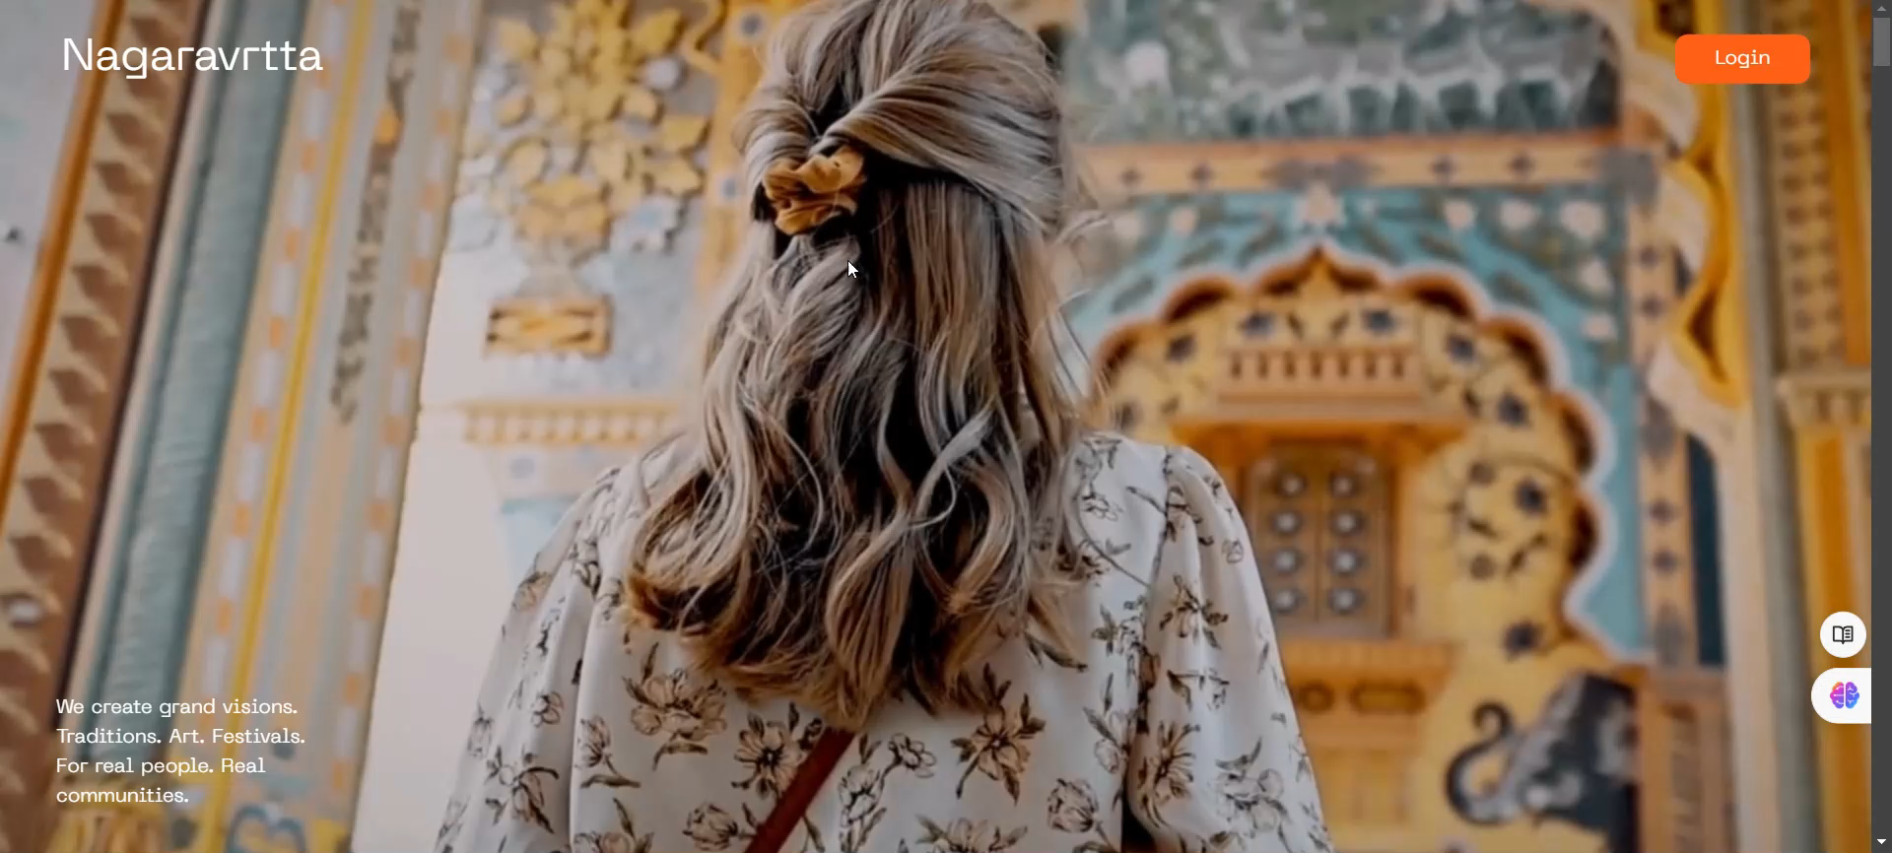
TECHNICAL APPROACH
Nivaran
Insights :-
Flowchart :-

Slide 4
FEASIBILITY AND VIABILITY
Nivaran
Analysis of Feasibility :
Potential Challenges and Risks :
Strategies for Overcoming Challenges :
1. Technical Feasibility:
Development Skills: Proficient in front-end and back-end development, ensuring intuitive UI and well-organized structure for optimal user experience.
Infrastructure: Employs cloud solutions and CDNs for reliable hosting and scalability, essential for maintaining high performance and availability.
2. Financial Feasibility:
Initial Investment: Secure funding through sponsorships, grants, or investments to support development, design, and marketing efforts.
Revenue Streams: Generate revenue through listings, sponsorships, and affiliate partnerships, focusing on strategic collaborations for long-term sustainability.
3. Market Feasibility:
Target Audience: High market potential due to interest in cultural tourism and heritage preservation; research ensures relevance.
Competition: Unique niche in lesser-known Indian culture differentiates from broader travel websites.
1. Technical Strategies:
Performance Optimization: Leverage caching, image compression, and CDNs for superior speed and efficient performance optimization.
Security Measures: Utilize SSL certificates, secure coding practices, and routine security audits to protect user data.
2. Financial Strategies:
Funding Sources: Leverage grants, sponsorships, crowdfunding, and strategic partnerships with cultural organizations for diverse funding streams.
Revenue Models: Experiment with various monetization strategies and collect user feedback to balance revenue and user experience.
3. Market Strategies:
Engagement Tactics: Leverage targeted marketing, social media strategies, and partnerships. Continuously refresh content to enhance user engagement.
Cultural Expertise: Partner with local experts for authentic representation. Use feedback loops to refine and improve cultural content.
1. Technical Challenges:
Website Performance: Optimize load times and navigation efficiency, especially with rich media, to enhance user experience and engagement.
Data Security: Implement robust security measures to protect user data and prevent potential breaches, ensuring comprehensive protection.
2. Financial Risks:
Funding: Navigating initial funding challenges and maintaining revenue through strategic sponsorships and listings.
Monetization: Balancing user experience with monetization strategies to avoid appearing overly commercialized.
3. Market Risks:
User Engagement: Overcome user engagement challenges by ensuring content resonates and using effective promotion strategies for retention.
Cultural Sensitivity: Prioritize accurate, respectful cultural representation to avoid backlash and enhance inclusive user experiences.

Slide 5
IMPACT AND BENEFITS
Nivaran
Potential Impact on the Target Audience :
Benefits of the Solution :
Support for Heritage Conservation: Boost awareness for lesser-known sites to enhance preservation and maintenance through targeted outreach and tech integration.
Community Engagement: Foster user interaction with sharing and reviews, creating a network of cultural ambassadors via digital platforms.
Economic Benefits for Rural Areas: Distributes tourism benefits to smaller towns, creating jobs and promoting economic development.
Cultural Exchange: Connect travelers with local traditions to enhance cross-cultural understanding and enrich global interactions.
Sustainable Tourism: Promote responsible travel by supporting less-visited destinations and local businesses with eco-friendly practices.
Personalized Recommendations: Utilize algorithms to deliver tailored travel suggestions based on individual preferences and interests.
Interactive Content: Enhance user engagement with virtual tours and quizzes, providing a dynamic and immersive experience.
Cultural Institution Collaboration: Partner with museums and heritage organizations to enhance content accuracy and leverage expert insights.
Social Benefits:
Cultural Preservation: Showcasing traditions to preserve endangered cultural practices efficiently.
Community Engagement: Boosts local pride and heritage protection through interactive platforms.
Education and Awareness: Promotes cultural diversity using advanced educational tools and technologies.
2. Economic Benefits:
Boost to Local Economy: Tourism drives growth for small businesses and local accommodations.
Job Creation: Creates opportunities in tourism, guiding, and hospitality, especially in emerging locations.
Revenue from Sponsorships: Premium listings and affiliate partnerships ensure ongoing financial stability.
3. Environmental Benefits:
Sustainable Tourism: Promoting lesser-known areas alleviates overcrowding and enhances tourism balance and sustainability.
Conservation Support: Responsible tourism fosters conservation efforts and protects cultural heritage sites effectively.

Slide 6
RESEARCH AND REFERENCES
Nivaran
Reference and Research work :
Design & Data :
Acknowledgement :
Data Referred in website:
https://www.tourism.rajasthan.gov.in/
https://maharashtratourism.gov.in/
https://www.wikipedia.org/
https://www.udemy.com/course/animating-with-greensock/?couponCode=ST11MT91624A
Pro MERN Stack Book by Vasu Subramanian
Database Management Systems (DBMS) book by Rajiv Chopra
Design Inspirations :
https://www.behance.net/gallery/204876611/Travel-Tourism-UI-UX-Design?tracking_source=search_projects|tourism+ui+design&l=43
https://in.pinterest.com/
Video Used in website: https://youtu.be/m8qf5bSmlQQ?si=eJV8MZkhxWsFOtdD
Image Sources :
https://unsplash.com/
https://www.midjourney.com/home
https://images.google.com

